Slide 1
Fluid ph, reaction and saliva

Slide 2
Saliva
CONTEXT
The importance of saliva in our everyday activities and the medicinal properties it possesses are often taken for granted. However, when disruptions in the quality or quantity of saliva do occur in an individual, it is likely that he or she will experience detrimental effects on oral and systemic health.
It is believed that changes in saliva are indicative of the wellness of the patient. The thickness and smell of saliva, as well as patients gustatory sensation of their own saliva are all used as symptoms of a certain disease state of the body. The barriers to widespread implementation of saliva diagnostics derive from technological problems such as sensitivity, miniaturization, high-throughput, automation, portability, low cost, high functionality, and speed to enable detection and measurements of multiple disease markers in saliva have largely been overcome.
Studies in the early 20th century had shown evidence of the dietary effect of saliva. Highly sensitive assays such as RT-PCR, micro array, and nano-scale sensors that can measure proteins and nucleic acids with minimum sample requirement in a short period of time.

Slide 3
Saliva
RELEVANCE
Unlike blood testing, saliva analysis looks at the cellular level (the biologically active compounds) and therefore saliva is truly a representative of what is clinically relevant. Researchers experienced that in saliva analysis they are able to predict diagnose, or prevent many health problems and diseases.
Saliva Tests are promising as they are faster, cheaper, and potentially safer diagnostic method than Blood sampling. There is growing interest in saliva as a diagnostic fluid due to its simple and minimally invasive collection.
Same proteins present in blood are also present in saliva from fluid leakage at the gumline. It is considerably easier, safer, and more economical to collect saliva than to draw blood, especially in children and elderly patients.
While saliva tests won’t replace blood tests for all diagnostic applications, but in the future they could prove to be a potentially life-saving alternative to detect diseases where early diagnosis is critical, such as certain cancers.

Slide 4
Saliva, and fluid ph
RELEVANCE
Several tests are in the pipeline for uses ranging from pregnancy testing, Alcohol level testing and other drug detections.
Using a single saliva sample from a healthy, nonsmoking male, the researchers were able to identify 102 proteins, including 35 salivary proteins and 67 common serum proteins
With advancement in instrumentation, and technology, It is predicted that number of proteins identified in saliva will increase significantly and there will be increase in the a peak chance of detecting and preventing the diseases and, improving health conditions of humans
Hence, Salivary tests via Fluid PH, and other tests can be potential and relevant substitues to Blood tests in these coming years which can progress and become much safer options to go forward for health tests.

Slide 5
AIMS and objectives
The aim of this project is to investigate effective engagement strategies to increase the Salivary test which are potential substitutes to Blood tests.
To get diagnosted easily, and in affordable range for all
People for every tests.
To have the test results better and competitive enough to fight blood tests as a substitute.
To make the tests Easy, Cheaper, affordable, reliable, and safer than Blood tests.
To identify the most significant factors and conduct as many experiments as possible to measure the impact of Salivary tests

Slide 6
requirements
Sterlic Single collection tube
Ethanol Solution
pH paper
phlebotomy tube
arterial blood gas syringe
Biosensors
Non Invasive GCF glucose monitoring system

Slide 7
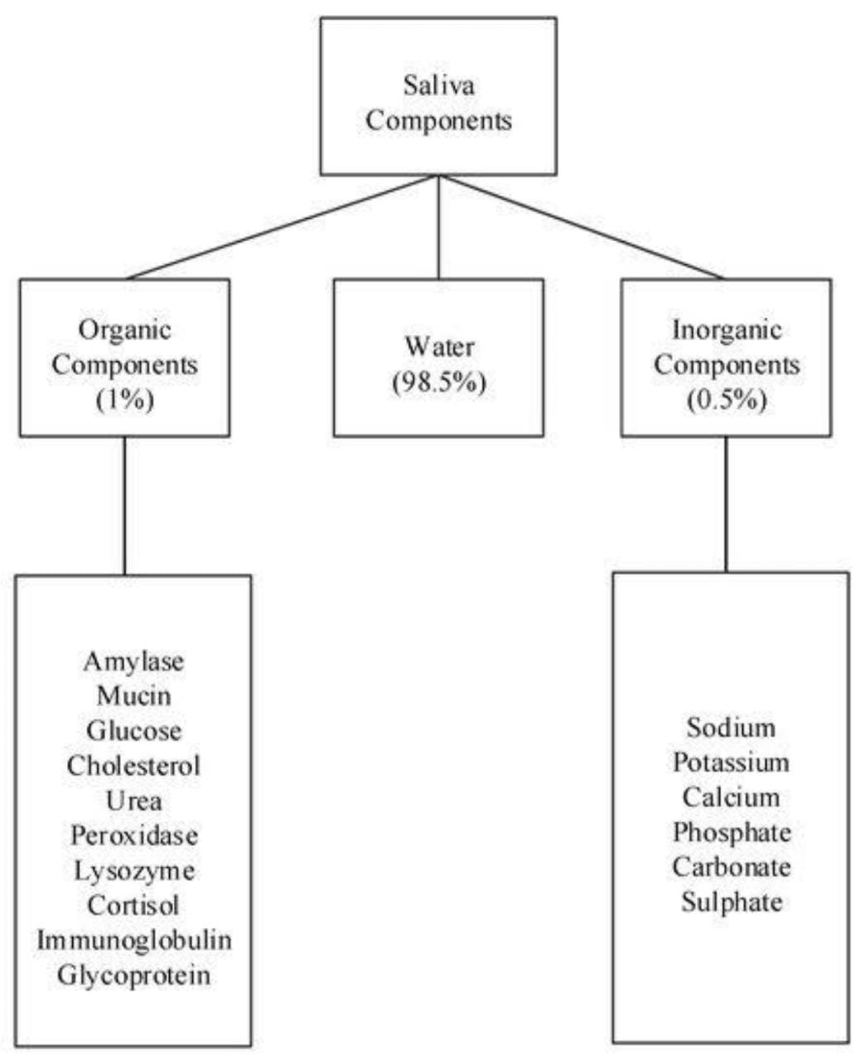

Slide 8
saliva
Steelic single collection tube
Ph value
Bio sensor
Concentration of enzyme
Display

